Slide 1
Scraping Ratings and Reviews on Ratemyprofessors

Slide 2
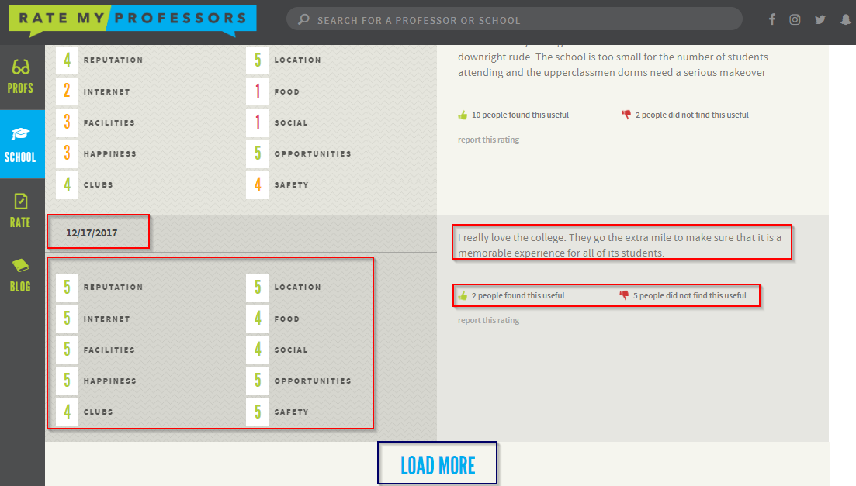
Sample page in RMP

Slide 3
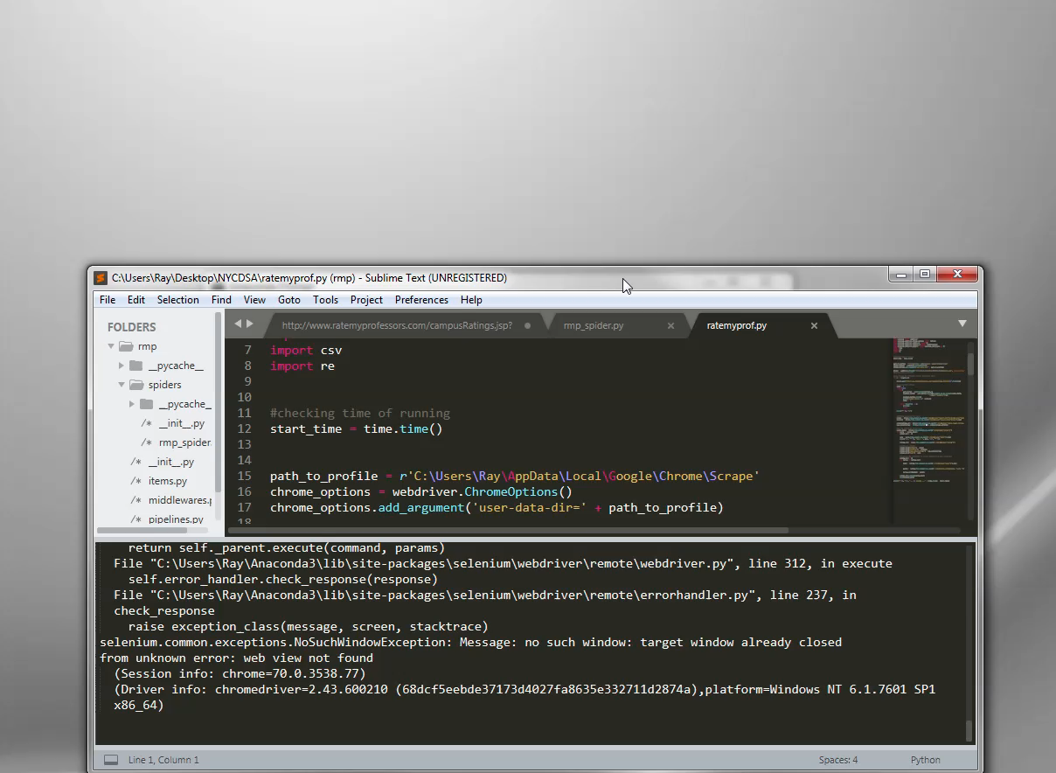
Scraping using just Selenium

Slide 4
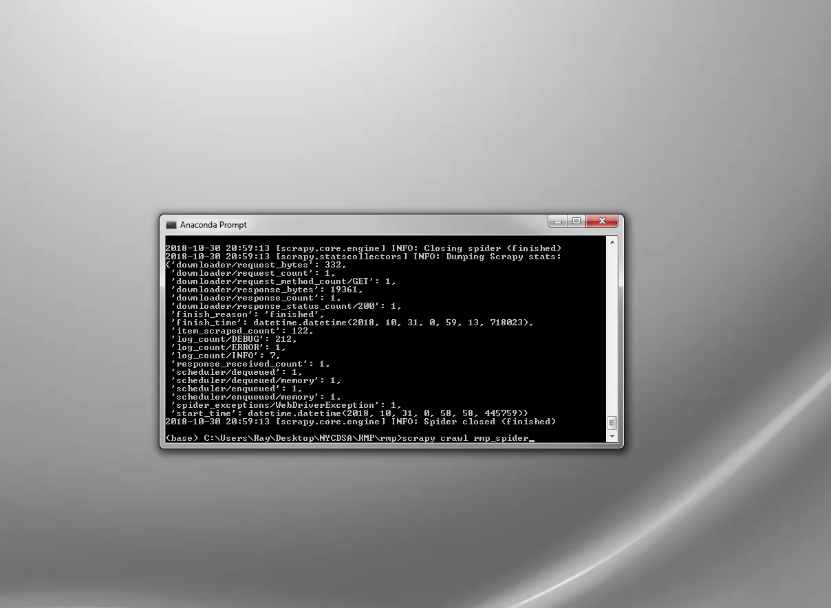
Scraping using Selenium/Scrapy Combination

